Slide 1
Supporting Connections at Washington state doc

Slide 2
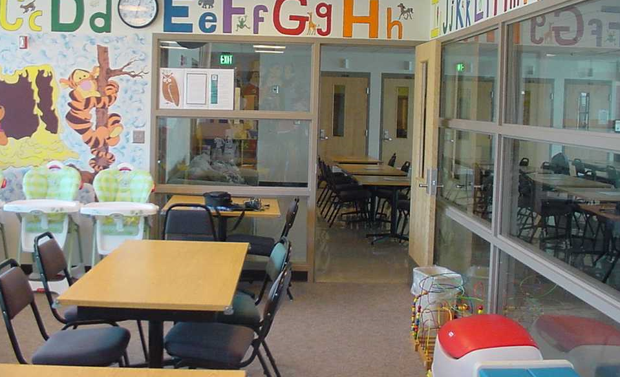
Women’s Prisons Medium, Close, & minimum
Washington Corrections Center for Women (Gig Harbor, WA)
Courtesy of WA DOC Family Services Division, 2018
Notes:
Pierce County
Capacity: 738
Opened: 1971

Slide 3
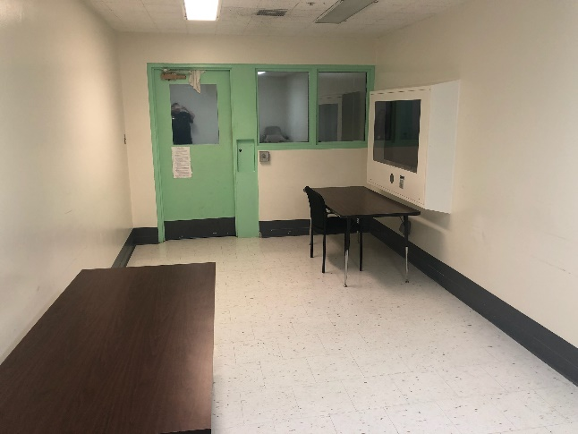
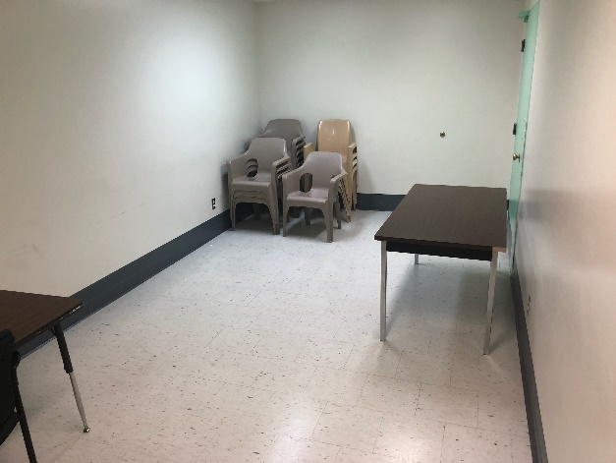
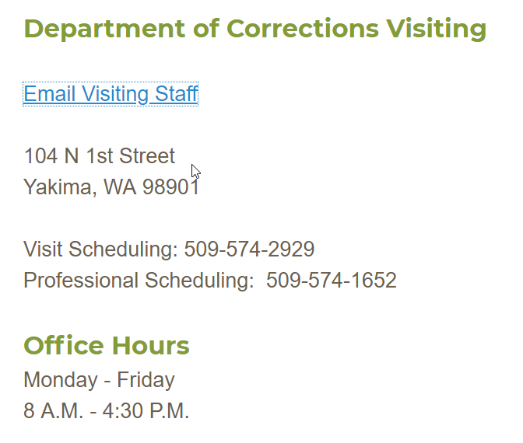
Women’s Prison beds-eastern Washington Long-term minimum
Washington Corrections Center for Women
at Yakima County Jail (Yakima, WA)
Under 40 women held as of May 2018
In-person contact visiting for WCCW women on Sundays.
At least one week’s notice is required to schedule.
Notes:
Yakima County
Capacity: 60 (39 women as of May 22, 2018)
Opened: 2014

Slide 4
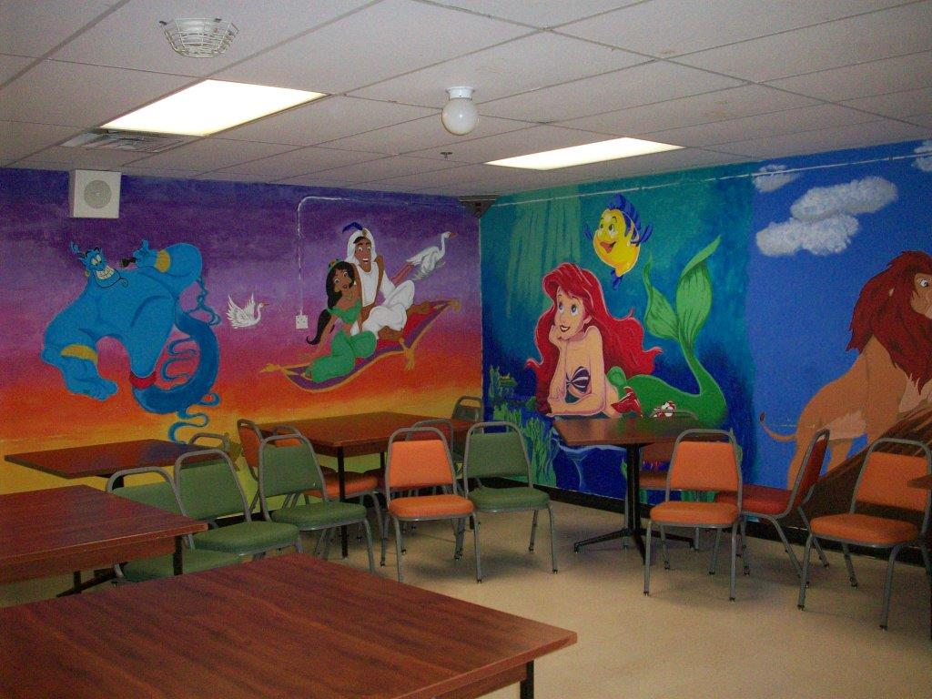
Women’s Prisons-western washington Minimum
Mission Creek Corrections Center (Belfair, WA)
Courtesy of WA DOC Family Services Division, 2018
Notes:
Mason County
Capacity: 321
Opened: 2005

Slide 5
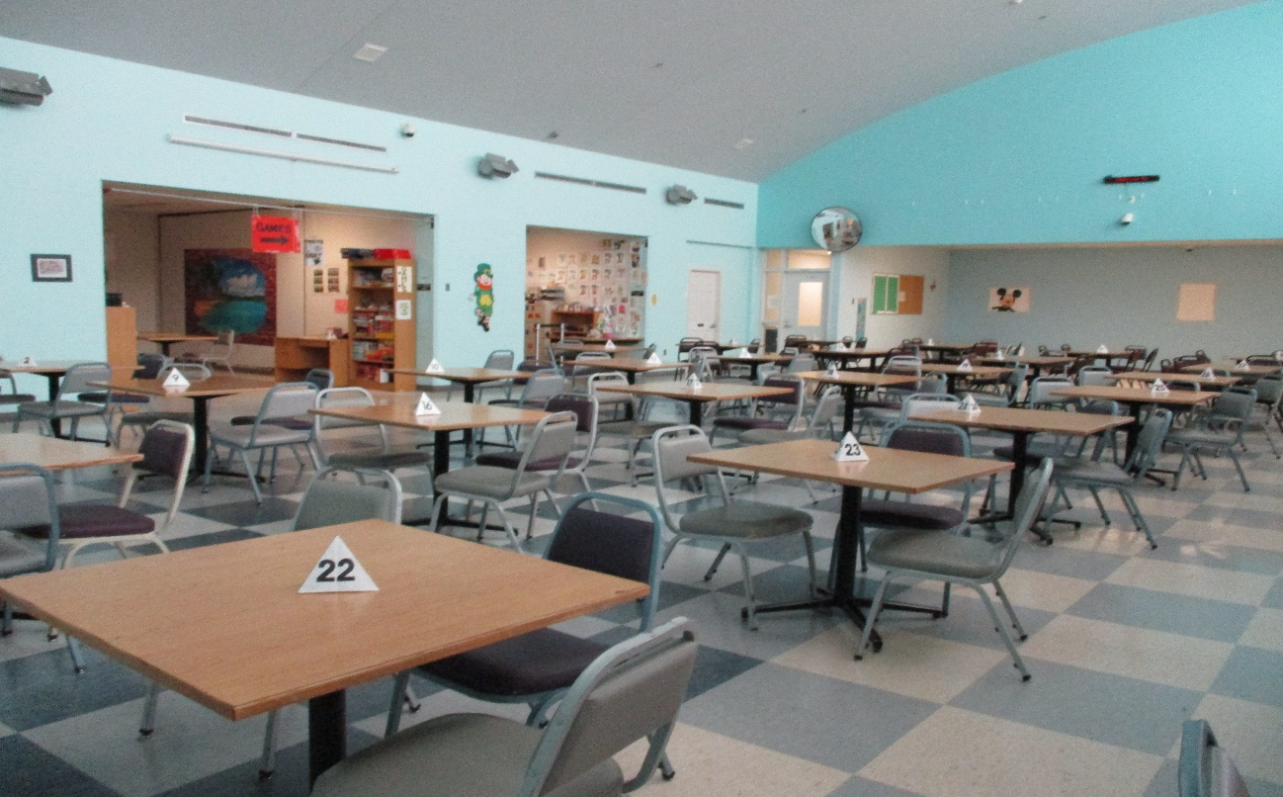
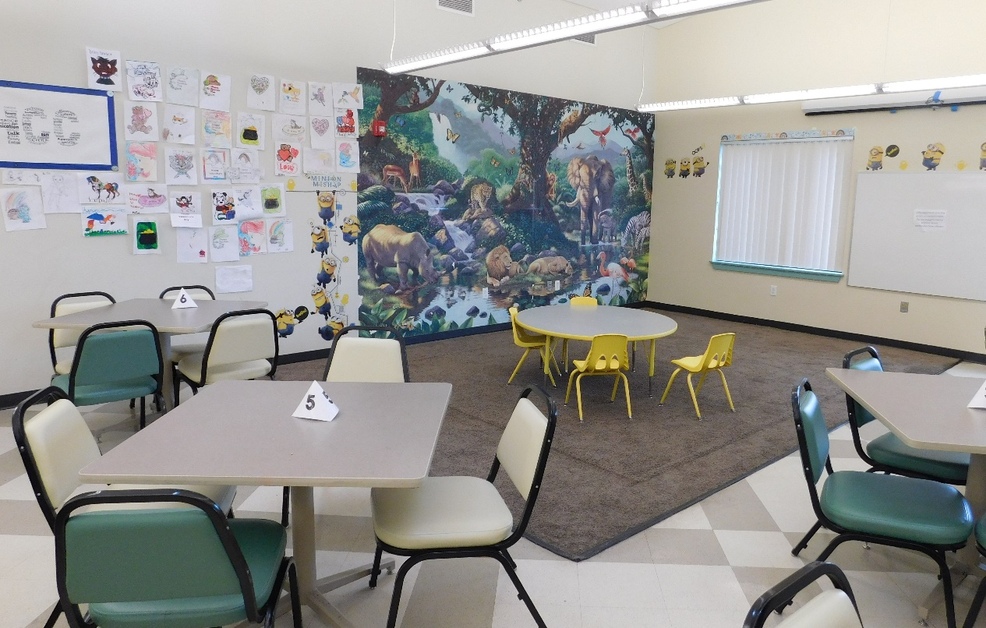
Men’s Prisons-eastern Washington Medium, Close, & minimum
Airway Heights Corrections Center (Airway Heights, WA)
Corrections Center
Minimum Security Unit
Courtesy of WA DOC Family Services Division, 2018
Notes:
Spokane County
Capacity: 2,258
Opened: 1992

Slide 6
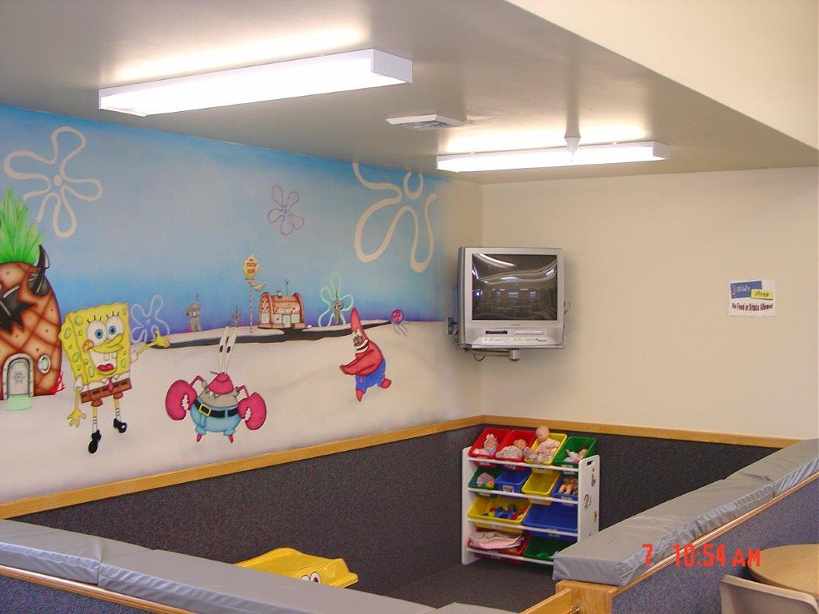
Men’s Prisons-eastern Washington Medium, Long-Term Minimum, & Minimum
Coyote Ridge Corrections Center (Connell, WA)
Courtesy of WA DOC Family Services Division, 2018
Notes:
Franklin County
Capacity: 2,468
Opened: Minimum-1992, Medium-2009

Slide 7
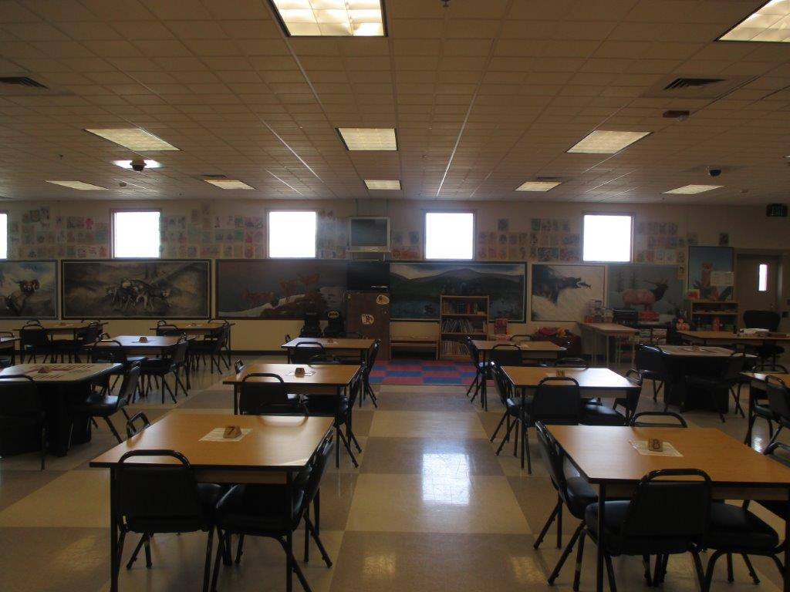
Men’s Prisons-eastern Washington maximum, close, medium, & minimum
Washington State Penitentiary (Walla Walla, WA)
Courtesy of WA DOC Family Services Division, 2018
Notes:
Walla Walla County
Capacity: 2,439
Opened: 1886

Slide 8
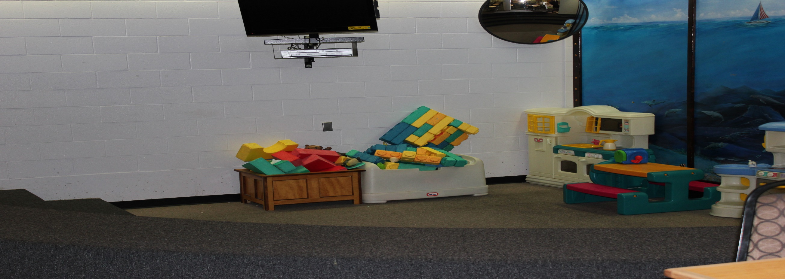
Men’s prisons-western Washington maximum, Close, & Medium
Clallam Bay Corrections Center (Clallam Bay, WA)
Courtesy of WA DOC Family Services Division, 2018
Notes:
Clallam County
Capacity: 858
Opened 1985

Slide 9
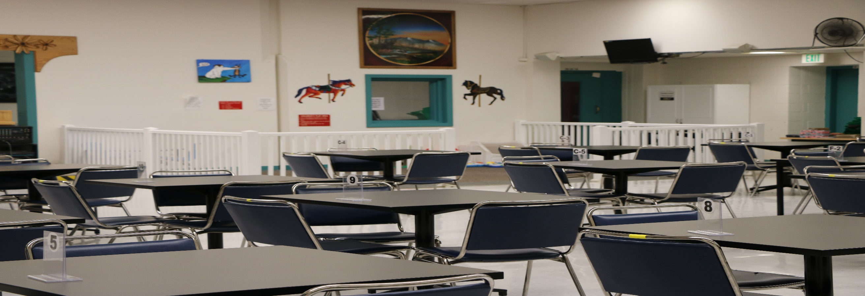
Men’s prisons-western Washington maximum, Close, medium, & minimum
Monroe Corrections Complex (Monroe, WA)
Courtesy of WA DOC Family Services Division, 2018
Notes:
Snohomish County
Capacity: 2,400
Opened 1910

Slide 10
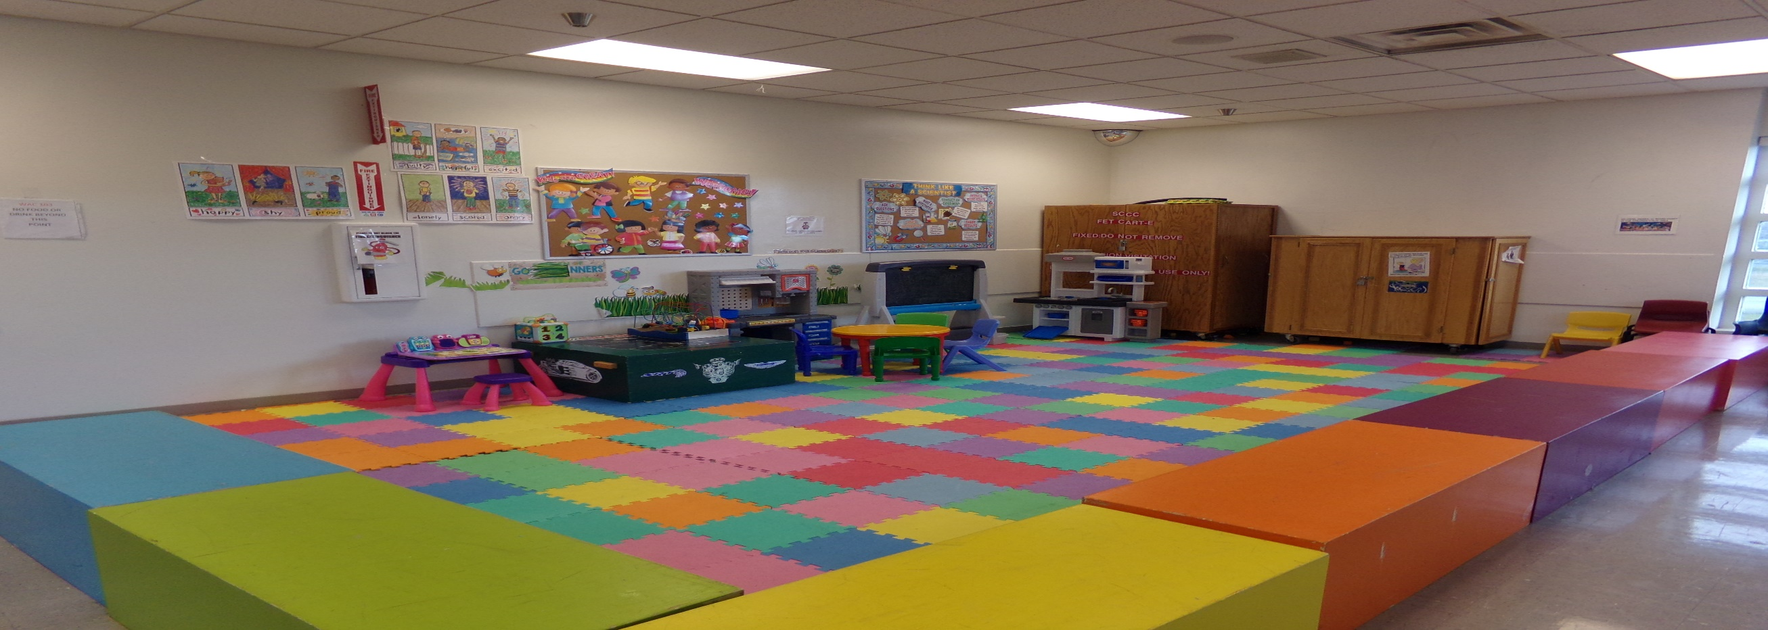
Men’s prisons-western Washington maximum, medium, & minimum
Stafford Creek Corrections Center (Aberdeen, WA)
Courtesy of WA DOC Family Services Division, 2018
Notes:
Grays Harbor County
Capacity: 1,936
Opened 2000

Slide 11
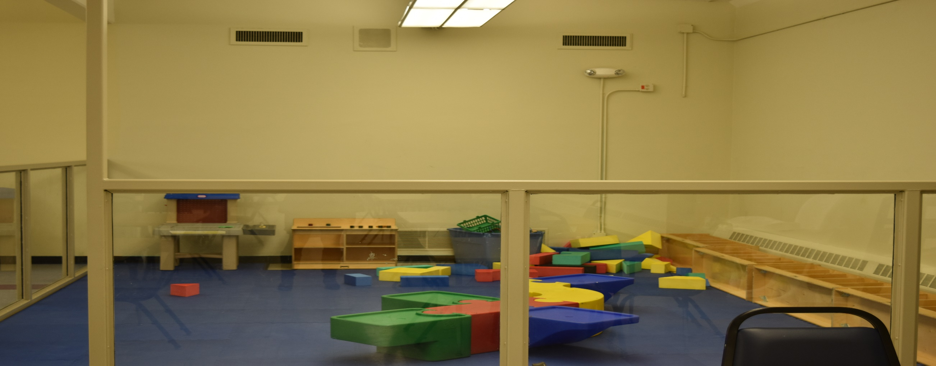
Men’s prisons-western Washington maximum, Close, & medium
Washington Corrections Center (Shelton, WA)
Courtesy of WA DOC Family Services Division, 2018
Notes:
Mason County
Capacity: 1,268
Opened 1964

Slide 12
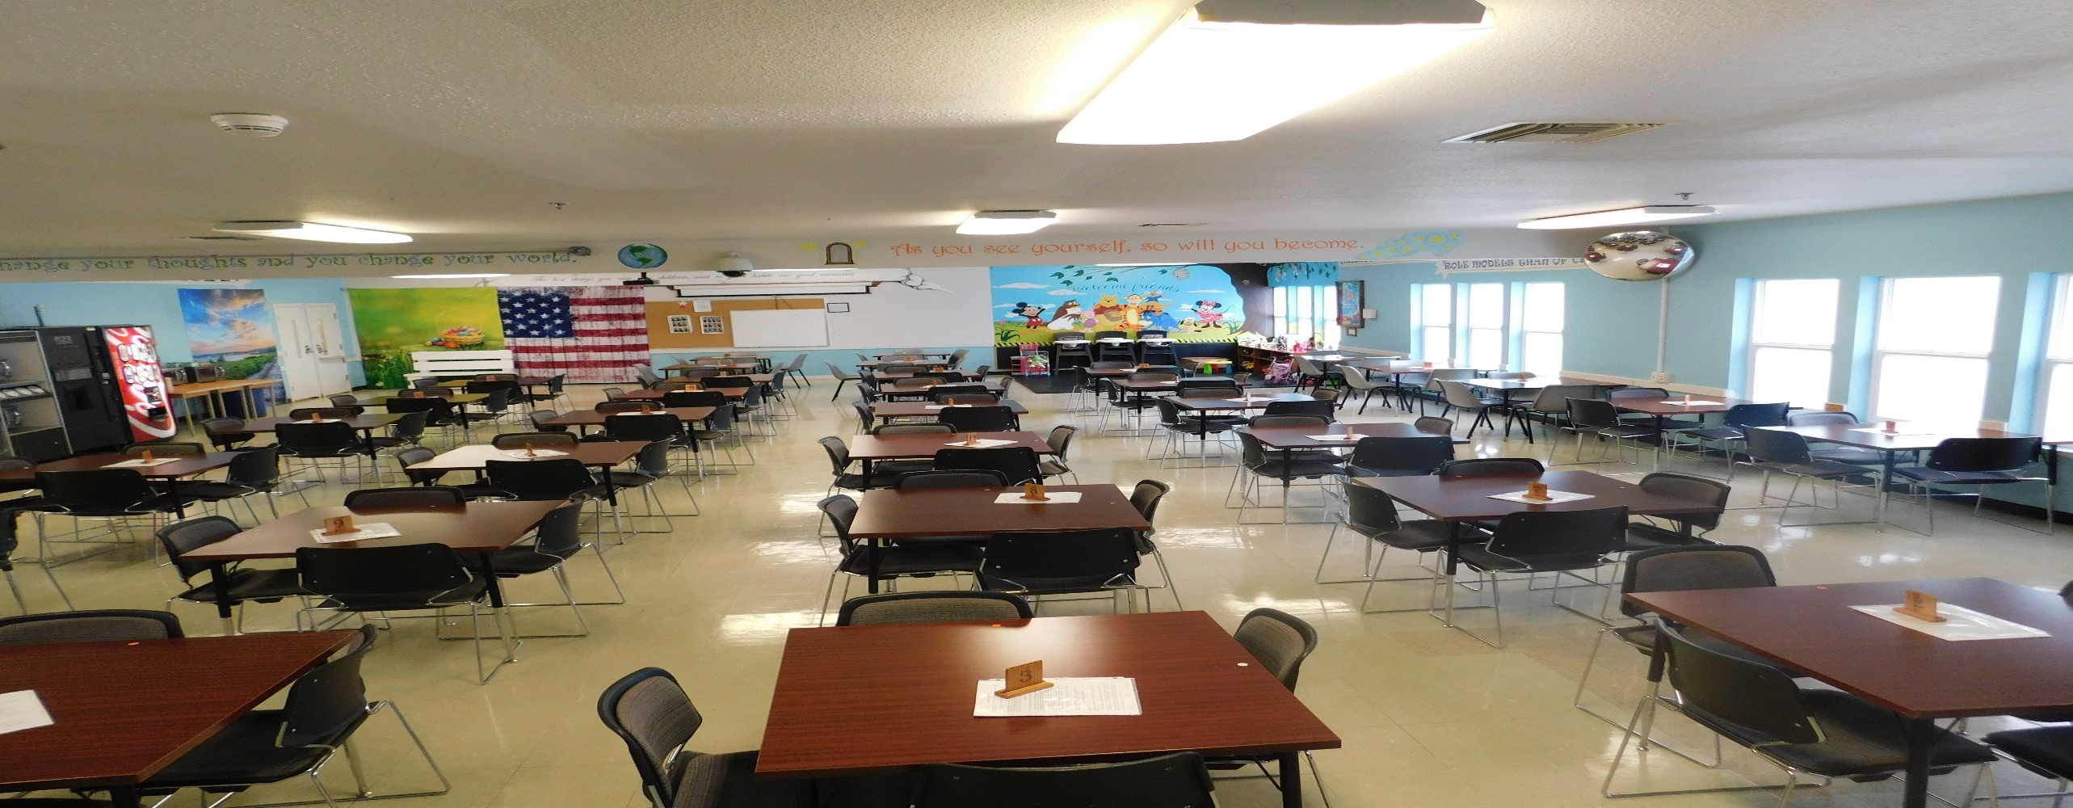
Men’s prisons-western Washington minimum
Cedar Creek Corrections Center (Littlerock, WA)
Courtesy of WA DOC Family Services Division, 2018
Notes:
Thurston County
Capacity: 480
Opened 1954

Slide 13
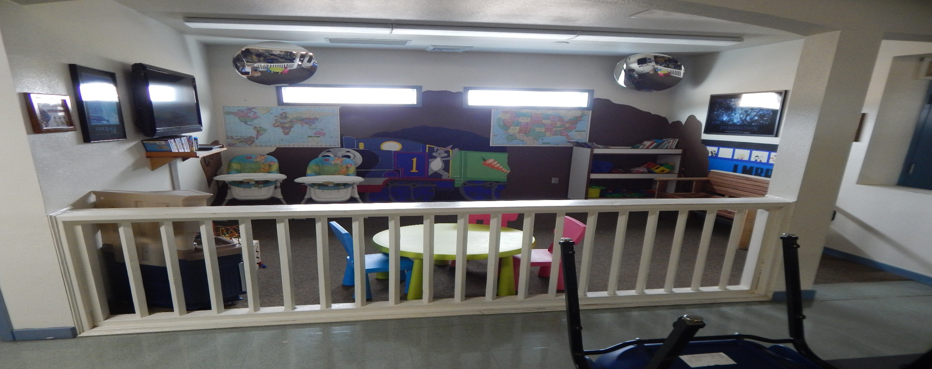
Men’s prisons-western Washington minimum
Larch Corrections Center (Yacolt, WA)
Courtesy of WA DOC Family Services Division, 2018
Notes:
Cowlitz County
Capacity: 480
Opened 1956

Slide 14
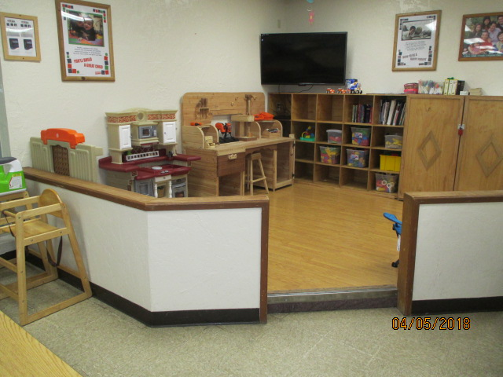
Men’s prisons-western Washington minimum
Olympic Corrections Center (Forks, WA)
Courtesy of WA DOC Family Services Division, 2018
Notes:
Jefferson County (west of Olympic National Park)
Capacity: 381
Opened 1968

