Slide 1
Washington Family Treatment Courts Best Practice Standards Training
Best Practice Overview: Behind the Document
Facilitator: Meghan R. Fitzgerald, PhD

Slide 2
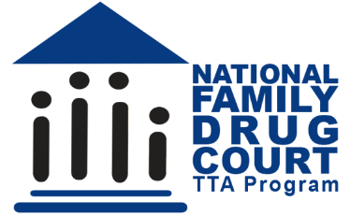
Funding and Partners Acknowledgement
This project is supported by Grant # 2020-AR-BX-K001 awarded by the Office of Juvenile Justice and Delinquency Prevention, Office of Justice Programs, U.S. Department of Justice. The opinions, findings, and conclusions or recommendations expressed in this publication/program/exhibition are those of the author(s) and do not necessarily reflect those of the Department of Justice or our partner organizations.

Slide 3
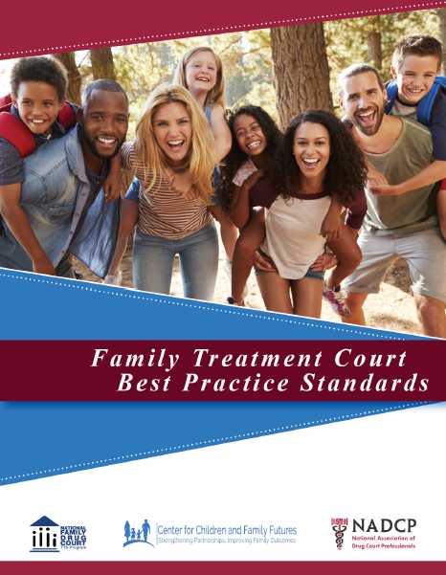
Learning Goals Best Practices Overview
Develop a familiarity with the Best Practice Guide
Introduce tools to help with your implementation of the FTC Best Practice Standards
Assess your level of understanding of this guide as a baseline for future work

Slide 4
Materials
Mindfulness tools

Slide 5
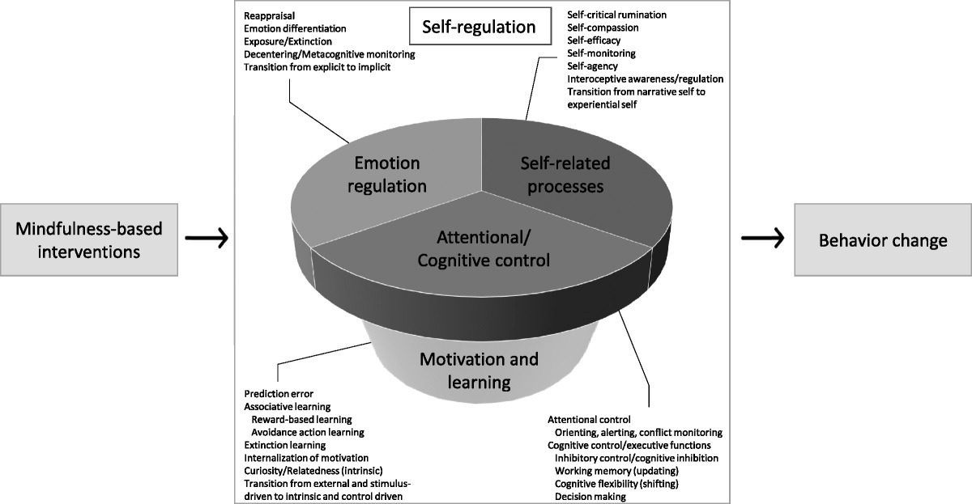
Mindfulness
Schuman-Olivier et al, 2020
Harvard Review of Psychology
Notes:
https://journals.lww.com/hrpjournal/Fulltext/2020/11000/Mindfulness_and_Behavior_Change.3.aspx

Slide 6
quote

Slide 7
Materials
Mindfulness tools Attentiveness and Cognition (Schuman-Olivier, 2020)
Trauma Informed Practice – Best Practice One Provision H
FTC Best Practice Pdf or Printed Booklet
Materials from your court: Policy and Procedure Manual, MOU documents, Participants Manual, and any other developed materials that could use review.
Notes:
https://journals.lww.com/hrpjournal/Fulltext/2020/11000/Mindfulness_and_Behavior_Change.3.aspx

Slide 8
How to Use the Best Practice Standards
FYJP, CFF and NADCP have copies for download
Basic Layout:
Overview Section:
Executive Summary, p iii-vi
Extensive list of writers and reviewers
8 Best Practice Standards
Provisions for each standard
rationale and key considerations
Notes:
Download the Pdf: https://www.wacita.org/wp-content/uploads/2021/09/Family-Treatment-Court-Best-Practice-Standards_Final2.pdf

Slide 9
Sample of the research behind these recommendations
Bruns, E. J., Pullmann, M. D., Weathers, E. S., Wirschem, M. L., & Murphy, J. K. (2012). Effects of a Multidisciplinary Family Treatment Drug Court on Child and Family Outcomes: Results of a Quasi-Experimental Study. Child Maltreatment, 17(3), 218–230.
Notes:
https://doi.org/10.1177/1077559512454216

Slide 10
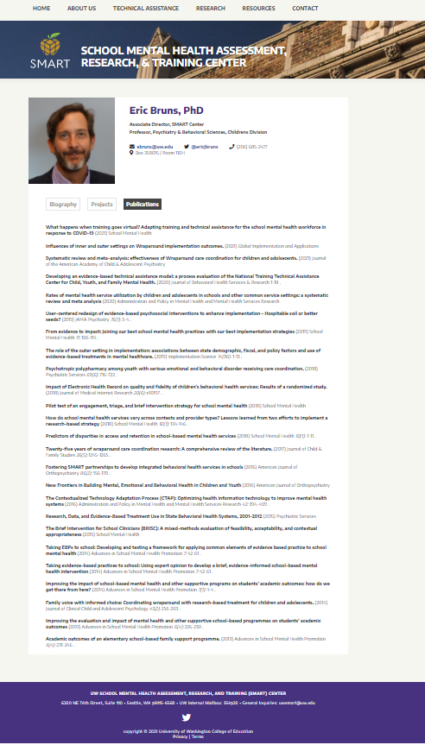
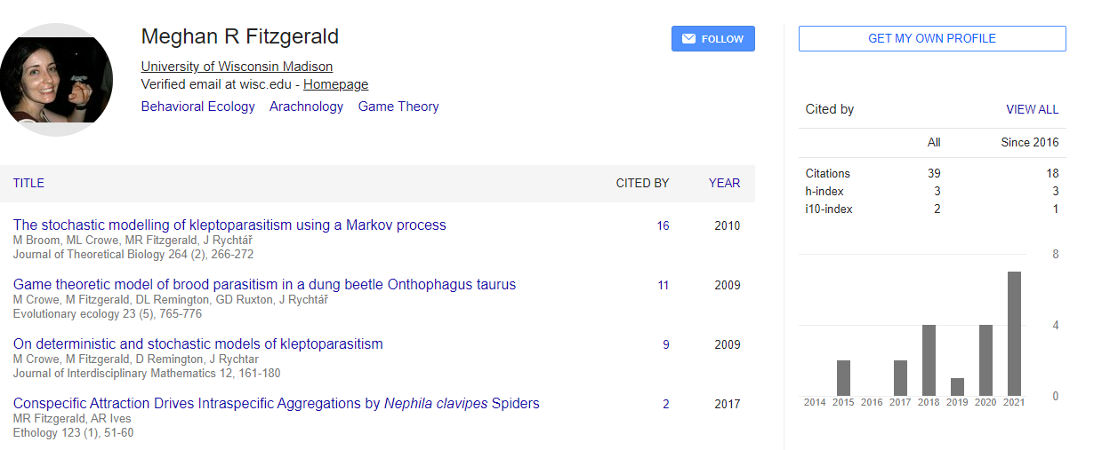
Reference demonstration
Notes:
https://smartcenter.uw.edu/profiles/eric-bruns-phd/
https://scholar.google.com/citations?user=Dkh-qNUAAAAJ&hl=en
https://scholar.google.com/citations?user=ZKECLlsAAAAJ&hl=en&oi=ao

Slide 11
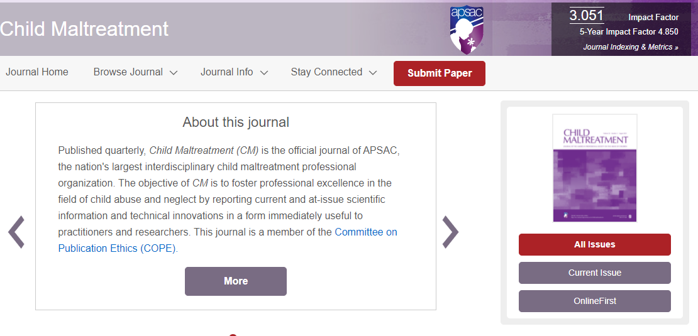
Journal Information
Notes:
https://journals.sagepub.com/home/cmx

Slide 12
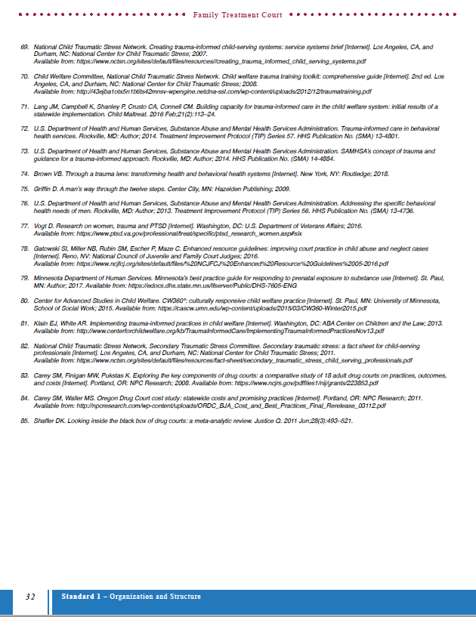
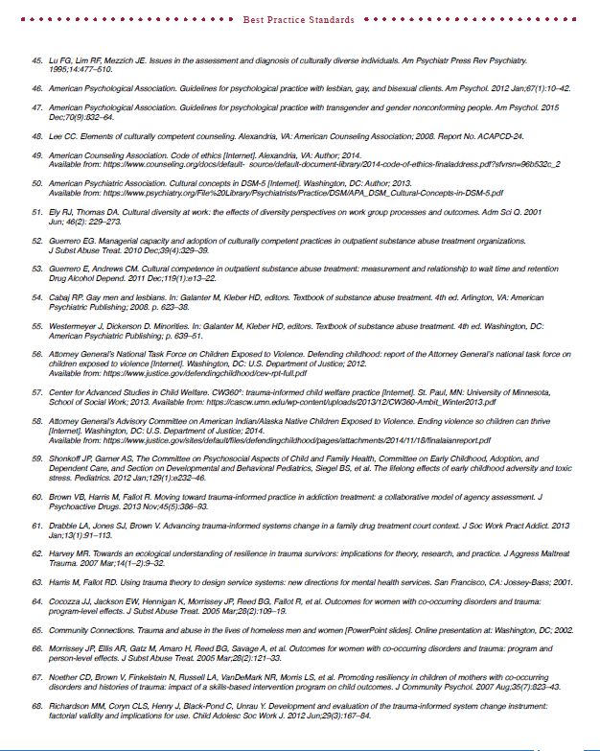
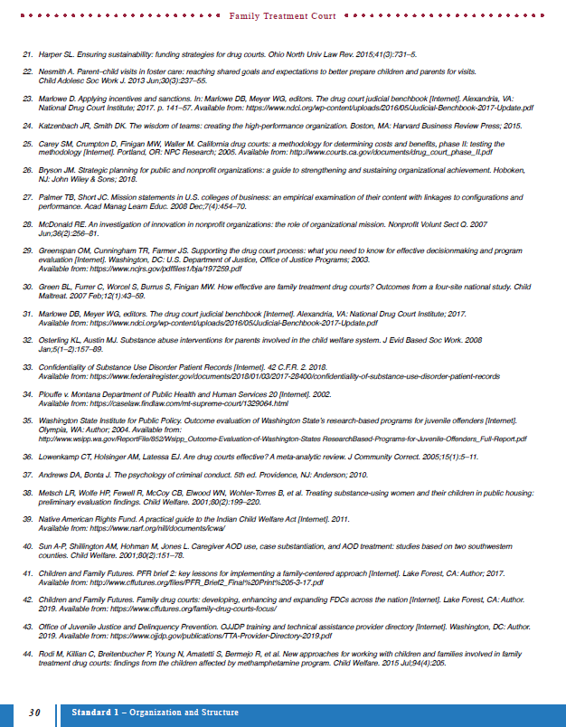
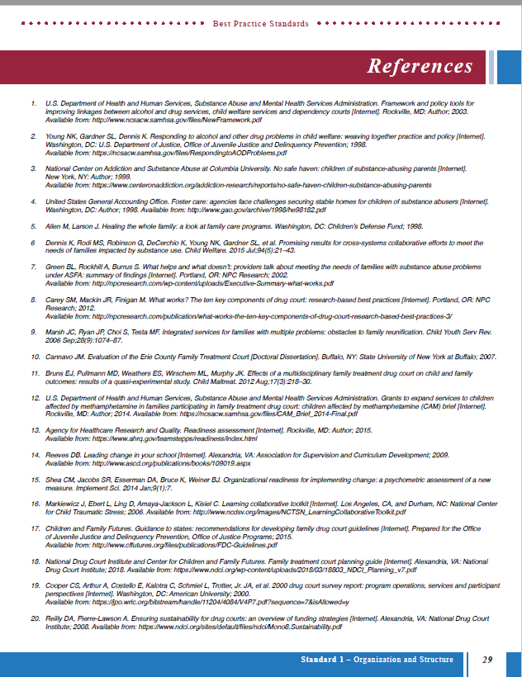
Sample of the research behind these recommendations
Notes:
TLDR
Perfect is the enemy of done.

Slide 13
Tools
Cheat Sheet
Transitioning to a family centered approach
Family Treatment Court Planning Guide
Notes:
https://www.wacita.org/wp-content/uploads/2021/09/FTC_BP_CheatSheet.pdf
https://www.nadcp.org/standards/family-treatment-court-best-practice-standards/

Slide 14
Team Learning Opportunities
Online Modules
Developed for new Team Members
Intro, BP 1 and BP 2 available now
Community of Practice
Listservs
CFF Technical Assistance
NADCP Training
SAMHSA Training
Crosstraining within your team

