Slide 1
Harm of Removal in Child Welfare
Threat to Safety
Harm of Removal
Presented by:
Laura Vogel, Administrative Office of the Courts’ Family & Youth Justice Programs
Jacob D’Annunzio, Office of Public Defense Parent Representation Program
October 23, 2023
Notes:
Laura
HB 1227 makes fundamental changes to how courts make decisions about child removal, including consideration of the harms that a child is likely to experience as a result of being forcibly removed, even temporarily. These changes acknowledge the inherent disruptions in attachment and development that occur as a result of being removed from a parent or primary caregiver, even in situations of abuse and neglect.

Slide 2
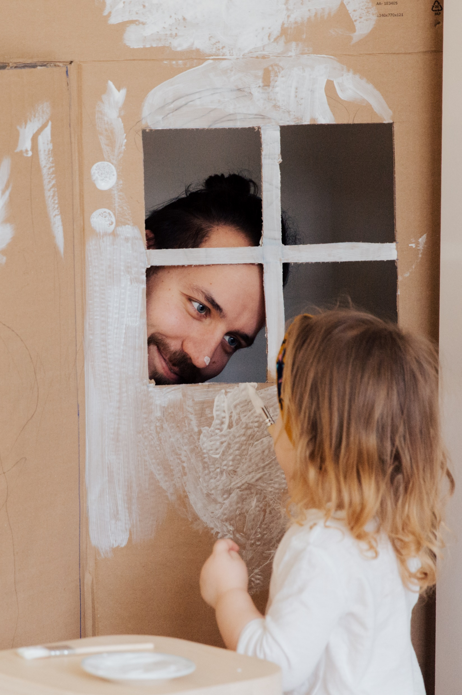
“Separating children from their families can cause irreparable harm, disrupting a child’s brain architecture and affecting his or her short- and long-term health.
This type of prolonged exposure to serious stress - known as ‘toxic stress’ - can carry lifelong consequences for children.”
-American Academy of Pediatrics
Notes:
Laura

Slide 3
“My home wasn’t perfect, but it was mine.”

Slide 4
s
E
C
A
Adverse Childhood Experiences
Average number of ACEs reported by adults formerly in foster care was 6
1/3 reported 8 or more
Placement into foster care does not stop the accrual of additional ACEs
Adverse Childhood Experiences and Psychosocial Well-Being of Women Who Were in Foster Care as Children, Delilah Bruskas, PhD, RN; Dale H Tessin, MS, Perm J 2013 Summer;17(3).
Notes:
Jacob 3 minutes

Slide 5
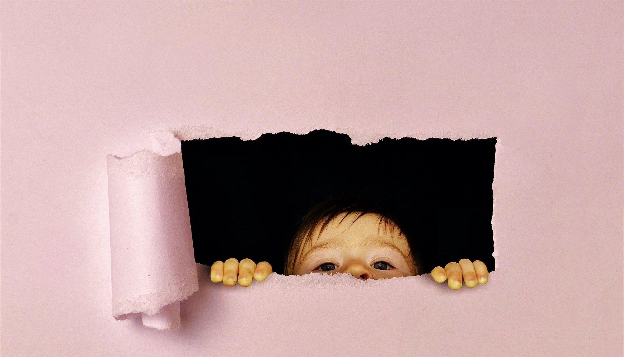
Ambiguous Loss
Physical absence with psychological presence
Notes:
Presenter(s): Jacob 5 minutes
Preoccupied
Left wondering
Without any answers
Leads to limbo - blocked from grieving, coping, healing,
Erodes resilience
Removal is especially traumatic when separation from parents or caregivers is sudden or without a sufficient transitional process.

Slide 6
Placement Reason Ambiguity
Structural Ambiguity
Placement Context Ambiguity
Relationship Ambiguity
Role Ambiguity
C.A.R.E.
Checklist
Mitchell, M. B. (2008). The transitioning into care project: Honoring children’s lived experience of the foster care transition. (Doctoral dissertation). ProQuest Dissertations and Theses database (UMI No. NR 47610).
Notes:
Presenter(s): Jacob 5 minutes
Structural Ambiguity: A lack of clarity about the meaning of foster care
Placement Reason Ambiguity: A lack of clarity about the reason for placement into foster care
Placement Context Ambiguity: A lack of clarity about the context of the placement into foster care
Relational Ambiguity: A lack of clarity about the people with whom they will be placed.
Role Ambiguity: A lack of clarity about one’s role in familial contexts
Temporal Ambiguity: A lack of clarity about the duration of the foster care placement
Ambiguous Loss: a lack of clarity about the psychological and/or physical presence of the members in the psychological family.

Slide 7
Patterns of Stress Activation
Unpredictable
Extreme
Predictable
Moderate
Prolonged
Sensitization/ Vulnerability
Controllable
Tolerance/ Resilience
Notes:
Jacob 2 minutes

Slide 8
Impacts of Toxic Stress
Parent-child separation is a source of
toxic stress for children.
Toxic stress changes how the body responds to stress and alters brain structure and functioning.
These disruptions in neurocognitive development put children at greater risk for a multitude of health and psychological impairments in adulthood.
Notes:
Parental separation is considered a toxic stressor, an experience that engages strong and prolonged activation of the body’s stress-management system. The physiological and psychological toll of early life stress, including parental separation, changes how the body responds to stress in the long term, disrupting higher-order cognitive and affective processes as well as negatively altering brain structures and functioning. Such stressors put children at greater risk for a multitude of health and psychological impairments, including anxiety, depression, post-traumatic stress disorder, lower IQ, obesity, immune system functioning, physical growth, cancer, heart and lung disease, stroke, and morbidity.
Parent-child separation has long-term effects on child well-being, even if there is subsequent reunification. After being separated, reunited children can experience difficulty with emotional attachment to their parents, self-esteem, and physical and psychological health For some children, time does not appear to fully heal these psychological wounds

Slide 9
The Research: Marginal Homes
Children “on the margin” of placement experienced improved outcomes when they remained at home as compared to similarly-maltreated children who were removed and placed into foster care.
(Doyle 2007; Doyle 2008; Doyle 2013)
“on the margin” which refers to cases where CPS investigators may disagree about the recommendation of removal.
Children placed into foster care were 2 to 3 times more likely to become involved with the criminal justice system as adults and experienced higher rates of arrest, conviction, and imprisonment as compared to those who remained home.
Child Protection and Adult Crime: Using Investigator Assignment to Estimate Causal Effects of Foster Care. Doyle, Joseph J. Journal of Political Economy Vol. 116, No. 4 (2008): 746-770.
Children who remained home were far less likely to experience teen pregnancy, commit a juvenile offense, and were more likely to hold a job for at least three months as compared to those placed into foster care.
Child Protection and Child Outcomes: Measuring the Effects of Foster Care. Doyle, Joseph J. American Economic Review Vol. 97, No. 5 (2007): 746-770.
Children placed into foster care were more likely to engage in juvenile delinquency and have the need for emergency care (3 times higher) as compared to those children who remained home.
Causal Effects of Foster Care: An Instrumental-Variables Approach. Doyle, Joseph J. Children and Youth Services Review Vol. 35, No. 7 (2013): 1143-1151.
Notes:
Laura
Three massive studies conducted by MIT researcher Professor Joseph Doyle examined the life outcomes of children in typical child welfare cases placed into foster care as compared to children experiencing the same sort of alleged abuse or neglect who were left in the home. These studies examined cases with children “on the margin”, which refers to cases where investigators may disagree about the recommendation of removal. Overall results showed better life outcomes for children on the margin of placement when they are able to remain home as opposed to being placed in foster care.
The first MIT study tracked 15,000 children involved with the child welfare system into late teens/young adulthood. The study compared children in foster care directly to similarly maltreated children who remained in their homes, in order to determine the causal effects of foster care placement on life outcomes. being far less likely to experience teen pregnancy, commit a juvenile offense, and were more likely to hold a job for at least three months as compared to similarly maltreated children who were placed into foster care. This was found to be true for all age-groups but was especially significant for older children.
The second MIT study involved tracking 23,000 cases and estimated the causal effects of foster care on adult crime, as compared to similarly maltreated children left in the home. Children on the margin of placement were found to be 2 to 3 times more to become involved with the criminal justice system as adults if they were placed in foster care. Children who were placed in foster care experienced higher rates of arrest (6-7.5% points), conviction (4% points), and imprisonment (3% points), as compared to similarly maltreated children who remained home. The study also found that Black children, girls and adolescents are more likely to be considered “on the margin, as compared to other children.
The third MIT study involved tracking outcomes for 15,681 children involved in the child welfare system to examine the causal effects of foster care on future delinquency and need for emergency medical care. Results showed that children placed into foster care were more likely to be delinquent (i.e., have an appearance before the juvenile court). The need for emergency care was 3 times higher among children placed in foster care as compared to similarly maltreated children who remained home. The results suggest that placing children in foster care increases their likelihood of becoming delinquent during adolescence and requiring emergency healthcare in the short term, indicating that foster care does not serve a protective role along this dimension of child safety.

Slide 10
The Research: Foster Care
Foster care children experience high rates of mental health disorders and are at an increased risk of experiencing negative long-term health outcomes.
Engler AD, Sarpong KO, Van Horne BS, Greeley CS, Keefe RJ. A systematic review of mental health disorders of children in foster care. Trauma, Violence, & Abuse. 2022;23(1):255-264.
Children who have been placed in foster care are:
7x as likely to experience depression
6x as likely to exhibit behavioral problems
5x as likely to feel anxiety
3x as likely to have attention deficit disorder, hearing impairments and vision issues
2x as likely to suffer from developmental delays, asthma, obesity and speech problems
Mental and Physical Health of Children in Foster Care http://pediatrics.aappublications.org/content/early/2016/10/14/peds.2016-1118
Notes:
Laura
Some may express outrage that the child wasn’t removed from the dangerous home sooner and placed in foster care – the intended social safety net for children who are unable to live with their birth parents. However, such a sentiment ignores the fact that foster care harbors its own threats to the safety and well-being of vulnerable children.
The foster care system works best when used to provide nurturing, short-term care to vulnerable children until a family crisis can be resolved and they can return safely home, or until a child can be placed with a permanent adoptive family. For many children, however, foster care is anything but short term. Languishing in foster care harms children’s wellbeing in a number of ways. The longer a child remains in temporary care, the more likely they will experience multiple placement changes and the disrupted relationships caused by such changes.

Slide 11
The Research: Disproportionate Impacts
Specifically Black & Indigenous Families
Acceptance for investigation (Zuravin et al., 2005)
Substantiation of alleged maltreatment (Ards, et al., 2003)
Placement in out of home care (Rivaux, et al., 2008)
NOT being placed with Relatives
Multiple Moves within the first 12 months
Length of time in placement
Longer time to reunification (Hill, 2005)
https://www.dcyf.wa.gov/sites/default/files/pdf/reports/CWRacialDisparityIndices2019.pdf
Notes:
Laura

Slide 12
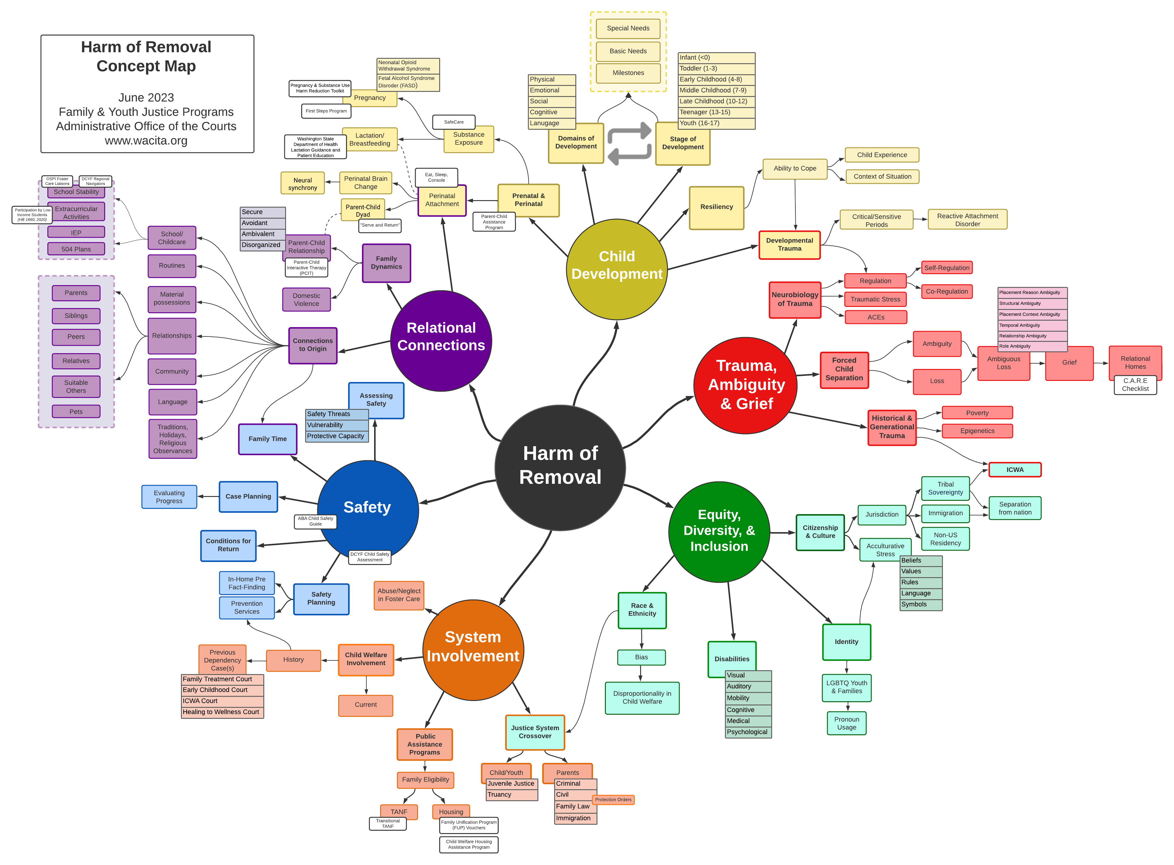
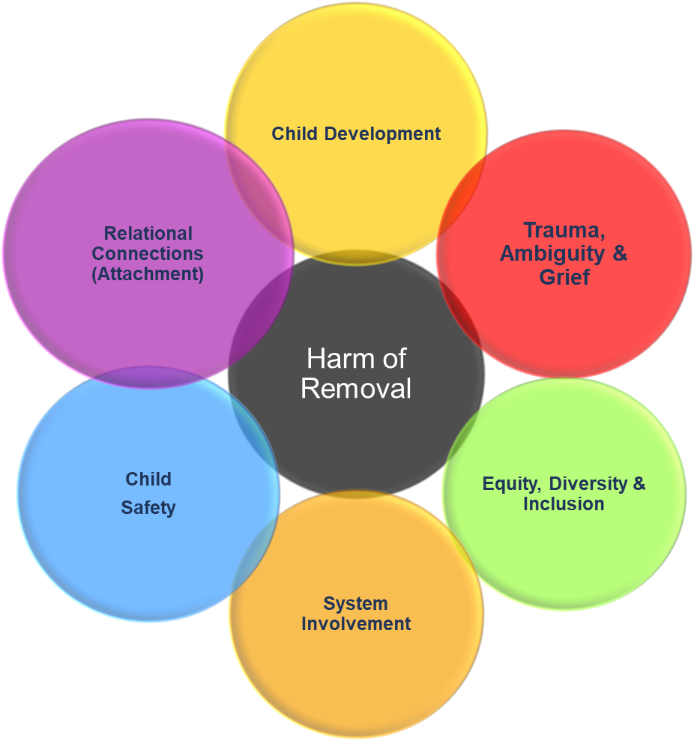
Notes:
Laura

Slide 13
Mitigation of Harm Through Relational Connections
“Connectedness has the power to counterbalance adversity.”
-Dr. Bruce Perry
Placement
Relative/suitable other
Supports reunification
Provides stability
Includes siblings
Child & Family Specific Mitigations
Race & Ethnicity
Religious observances
Culture & traditions
Language
Routines
Extracurricular activities
Medical & dental providers
Pets
Belongings
More…..
Family Time Visitation
Frequent / consistent
Least-restrictive, natural setting
Developmentally appropriate
Educational Stability
Same school
Pre-school and/or daycare
*Cannot do this without knowing the family*
Notes:
Jacob & Laura

Slide 14
Removal
Continued Separation
Transitions
Notes:
Original removal, continued separation, transitions

Slide 15
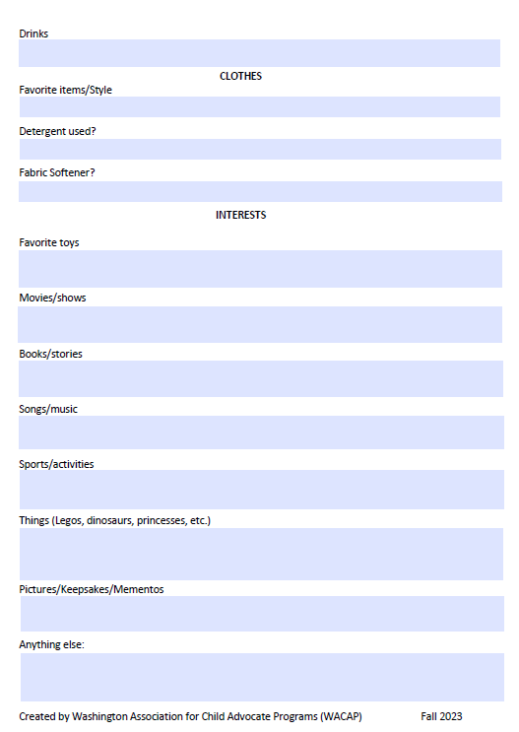
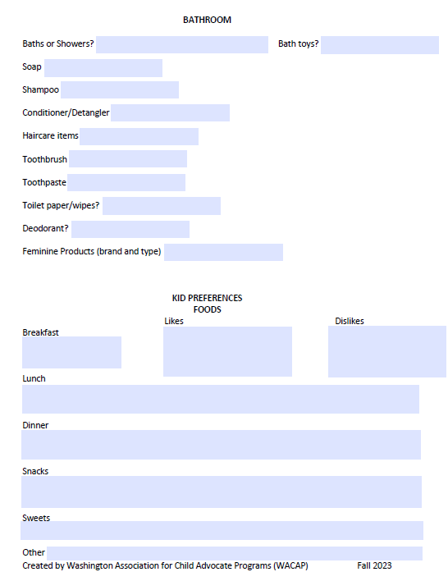
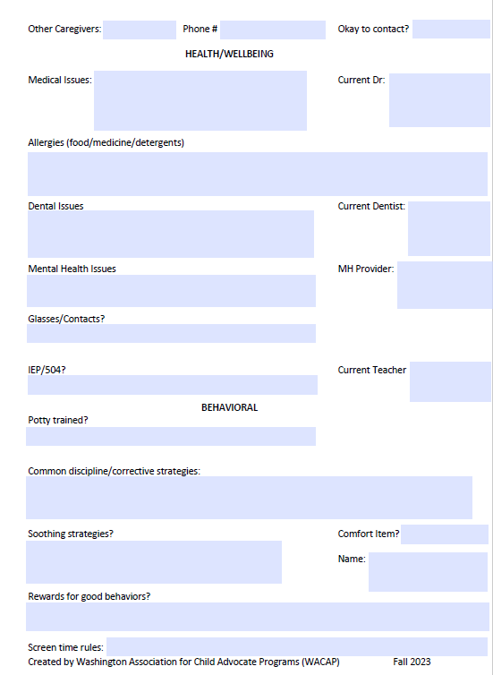
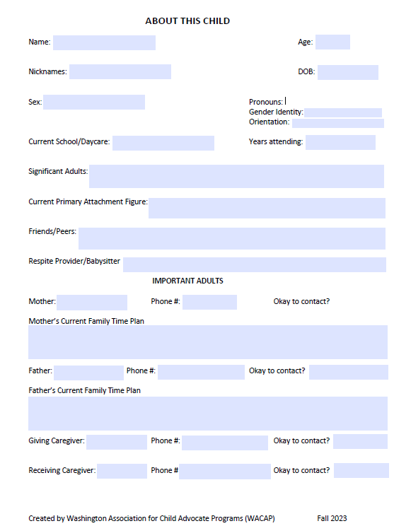
Removal & Continued Separation
Notes:
-punishing child because of the parent
-focusing on how to support the needs of the child
-behaviors are a reflection of need

Slide 16
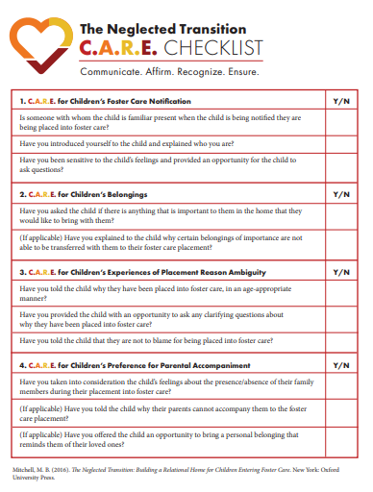
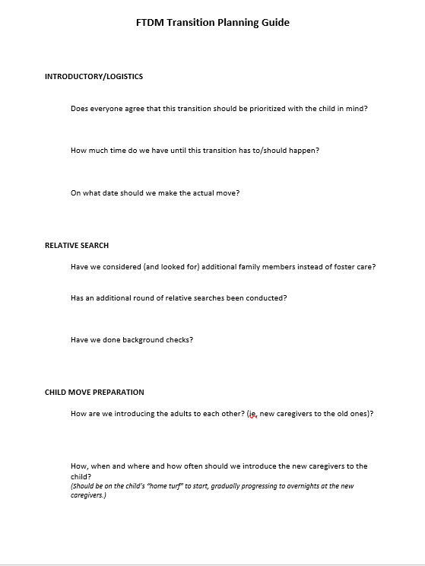
Transitions
C.A.R.E. Checklist
FTDM Transition Planning Guide
Notes:
Transitions: there needs to be a plan and there needs to be an FTDM where that plan is discussed in detail with all parties. Get critical, ask questions, don't make assumptions.

Slide 17
Let’s Practice!
Getting to Know Liam
8 year-old boy
In the third grade, same school and for three years, and in the community his whole life
Has been diagnosed with ADHD and Tourette’s syndrome.
Has a speech impediment that makes it difficult to understand many of his words.
Has had an IEP for 1 year, struggles with impulse control and is frequently corrected for his behaviors.
Low self-esteem and voices hating himself.
Has two older brothers, one who is 25 and lives 3 hours away and one who is 11.
Unlike his older brother (11), he displays all of his emotions through words and action with little to no filter.
His very best friend lives several blocks away and is in the same class.
Has been on the same soccer team since he was 4 – he lives for soccer. They practice Mondays and Wednesdays with games on Saturday.
The family dog is 2 weeks younger and Luca considers her his “little sister”.
Liam is removed from home on Friday evening and taken to a receiving home until placement can be determined at the Shelter Care Hearing on Monday.
Notes:
Jacob

Slide 18
Liam: Identifying Harms of Removal
Instructions
In pairs/groups
Discuss Liam’s situation and identify the different harms of removal that Liam would likely experience.
DO NOT jump to mitigation of harm of removal. We are not yet talking about what we can do, we are only identifying the likely harms of removal to Liam.
Notes:
Jacob
Articulate the damage done in the actual removal; harms that will result form continued family separation.
What in this scenario could contribute to a safety plan
This activity is designed to help you practice thinking critically about harm of removal by examining a set of facts through the perspective of the child. It is intentionally vague. That’s why information about the threats to safety that resulted in Luca being removed from the home is intentionally omitted here. You are not weighing harm of removal against the threat of safety. You are solely being asked to identify the how Luca’s world will change as a result of removal and the impacts of that on Luca.

Slide 19
Liam: Mitigating Harms of Removal
Instructions
Thinking about the list your group just made, what role could a child advocate play in helping mitigate the harmful impacts of removal to Liam?
Hint: Think about who and what is important to Liam
Notes:
Jacob
If removal happens, what strategies do you have for decreasing the harm to this child and promote successful reunification.

Slide 20
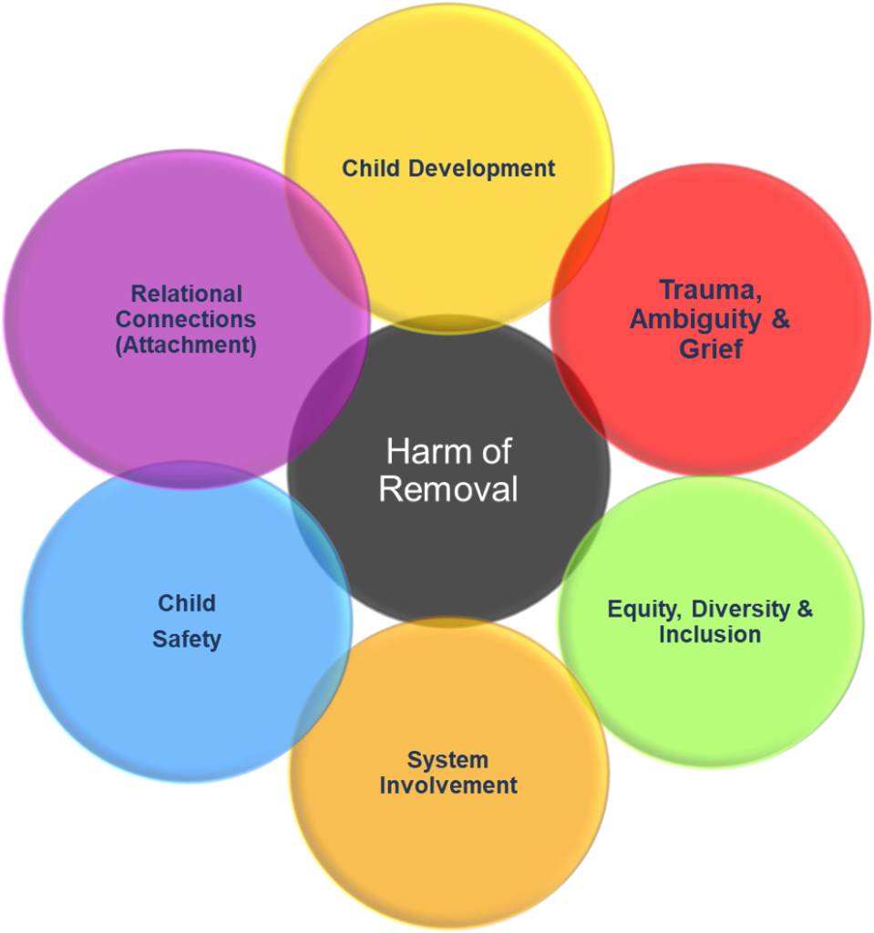
www.wacita.org
Resources
1
2
FYJP Harm of Removal Webpage
Harm of Removal Map
3
4
C.A.R.E. Checklist
Notes:
Tools were originally created for judicial officers, but there are no expectations or limitations for use.
Available to everyone.
No record created – doesn’t enter information.
Can be a teaching tool.
Can be used to prepare for court
Can be used on-the-bench; especially for pro tems or new judicial officers
Can be used to explain court process to parents and youth

Slide 21
Thank You!
Laura Vogel
laura.vogel@courts.wa.gov
Jacob D’Annunzio
Jacob.Dannunzio@opd.wa.gov
Notes:
Jacob & Laura

